Slide 1
BANK ACCOUNT MANAGEMENT SYSTEM(krypton bank) GROUP 8

Slide 2
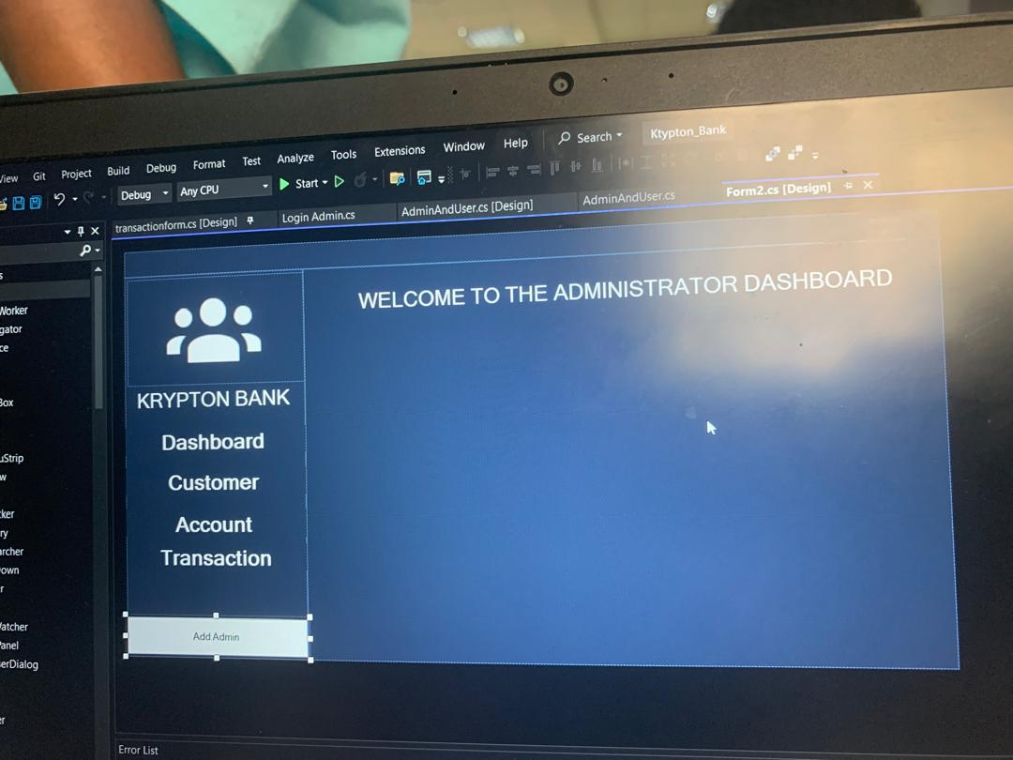
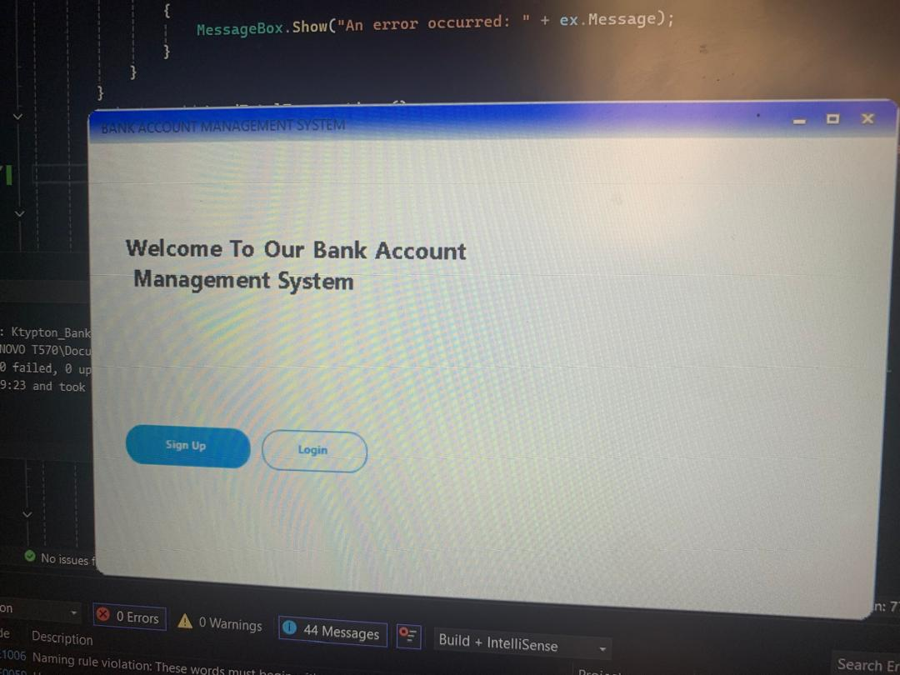
SUBTITLE : COMPREHENSIVE OVERVIEW AND DEVELOPMENT..
In the images below, is the display of the welcome page where a user can either sign in or login into an account and administrator dashboard.

Slide 3
CONTEXT OF THEPROJECT
INTRODUCTION :
The bank account management system serves as a digital platform for users to manage their banking needs, providing a user-friendly interface for financial transactions.
IMPORTANCE:
In the digital age, effective management of bank accounts is crucial for customer satisfaction and operational efficiency.
Traditional banking methods are increasingly being replaced by digital Traditional banking methods are increasingly being replaced by digital solutions, necessitating robust systems that carter to user needs.

Slide 4
OBJECTIVES'
*PRIMARY OBJECTIVE
Develop and Intuitive application that allows users to manage their checking an d savinggs accounts efficiently.
*SECINDARY OBJECTIVE
Ensure high levels of data security to protect sensitiv e information.
Implement features that enhance user experience,such as easy navigation and quick access to account information.

Slide 5
SCOPE OF THE PROJECT
CORE FEATUES
*User management
*Account management
*Transaction management

Slide 6
USER MANAGEMENT
*Profile creation:
Users can register with required personal details; name,email,phone number
*User Roles:
Implement different access levels to enhance security, ensuring sensitive functions are only accessible to authorised personnel.

Slide 7
ACCOUNT MANAGEMENT
*Account Types:
-Checking accounts: Designed for daily transactions, accesible via checks and debit cards.
-Savings account: Intended for savings with competitive interest rates
*Account Details :
-Users can view account numbers , types, balances, and transaction history
-Ability to set account preferences

Slide 8
TRANSACTION MANAGEMENT
*Deposits :-Users can deposit funds via direct deposit or manual entry
-The system checks for validity and updates the balance in real-time.
*Withdrawals:-Users can withdraw funds, with the system verifying that sufficient balance is abailableto prevent overdrafts.
-Instant notifications for successful or failed transactions
*Transaction History : -Users can view a detailed history of their transactions, including dates, amounts, types, and descriptions.

Slide 9
DATA PERSISTENCE
*DATABASE DESIGN ;
-Utilize MSSQL server for structured data storage
-Key tables include:
.Users: Stores user information
.Accounts: Stores account details linked to users
.Transactions : Logs all financial transactions
*TRANSACTION HISTORY;
-Maintain comprehensive records for auditing purposes and user reference

Slide 10
FUNCTIONAL ASPECTS
USER AUNTHENTICATION;
*Secure Login: -Implement multi-factor authentication(MFA) to enhance security
-Passwords encrypted using SHA-256 hashing
*Session management: -Secure session handling with timeouts and inactivity log out features to prevent unauthorized access.

Slide 11
ACCOUNT INFORMATION
*Account Overview:
-Users can view detailed information about their accounts, including balance and transaction summaries.
-Options to edit personal details securely, with validation checks in place.

Slide 12
PERFORM TRANSACTIONS ;
*Deposit Process: -Users select the account and enter the deposit amount
-The system validates the input and updates the account balance immediately.
*Withdrawal Process: -Users select the account and enter withdrawal amount
-The system checks for sufficient funds and processes the transaction, providing instant feedback.

Slide 13
NON-FUBCTIONAL ASPECTS
PERFORMANCE
*Response Time:
-Target response time of less than 2seconds for all transactions to ensure a smooth user experience
*Throughput:
-Designed to support atleast 100 concurrent users without performance degradation.

Slide 14
SECURITY
*Data Protection : -Use of TLS for encrypting data in transit
-Regualr security audits and vulnerability assessments to identify and mitigate risks
*Audit Logging : -Maintain detailed lohs of all user activities for compliance and security monitoring.

Slide 15
USABILITY
*User Interface Design : -Focus on intuitive navigation with clear labels and instructions
-Mobile-responsive design to cater to users on various devices
*Feedback Mechanism: -Implements a feedback form for users to report issues or suggest improvements .

Slide 16
TECHNICAL ASPECTS
DEVELOPMENT ENVIRONMENT
*Tools Used;
*Development: Visual studio for C# development
*Version Control: Git for tracking changes and collaboration among team memdowntimebers
TEST ENVIRONMENT
-Separate testing environments to ensure stable releases and minimize

Slide 17
NECESSARY RESOURCES
HUMAN RESOURCES
-Team Structure includes:
-Software Developers: Focus on coding and functionality.
-Database Administrator: Manages the database schema and performance
-Project Manager: Oversees the project timeline and deliverables.
-QA Tester: Ensures quality through rigorous testing
PHYSICAL RESOURCE
Development machines, servers for database management, and backup solitions for data recovery.

Slide 18
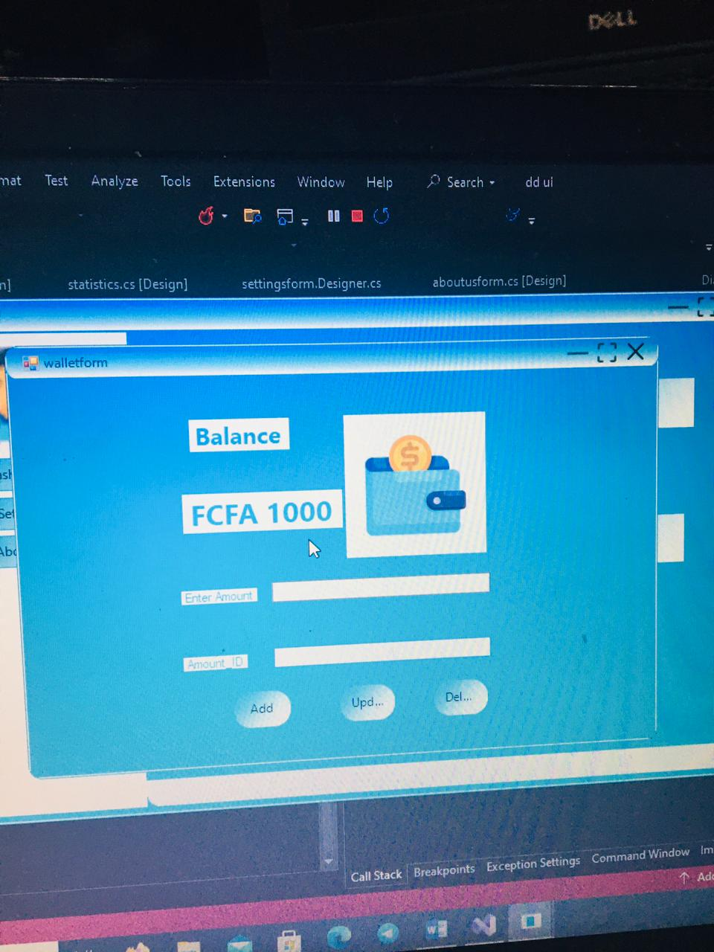
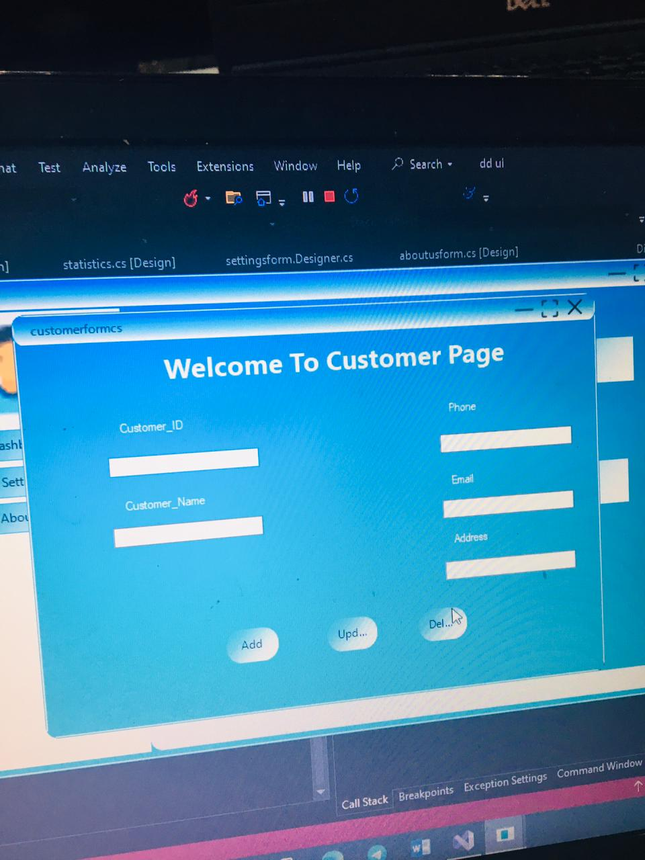
Below, we have some images displaying the settings, walletform/page, transaction page, customer page etc.

Slide 19
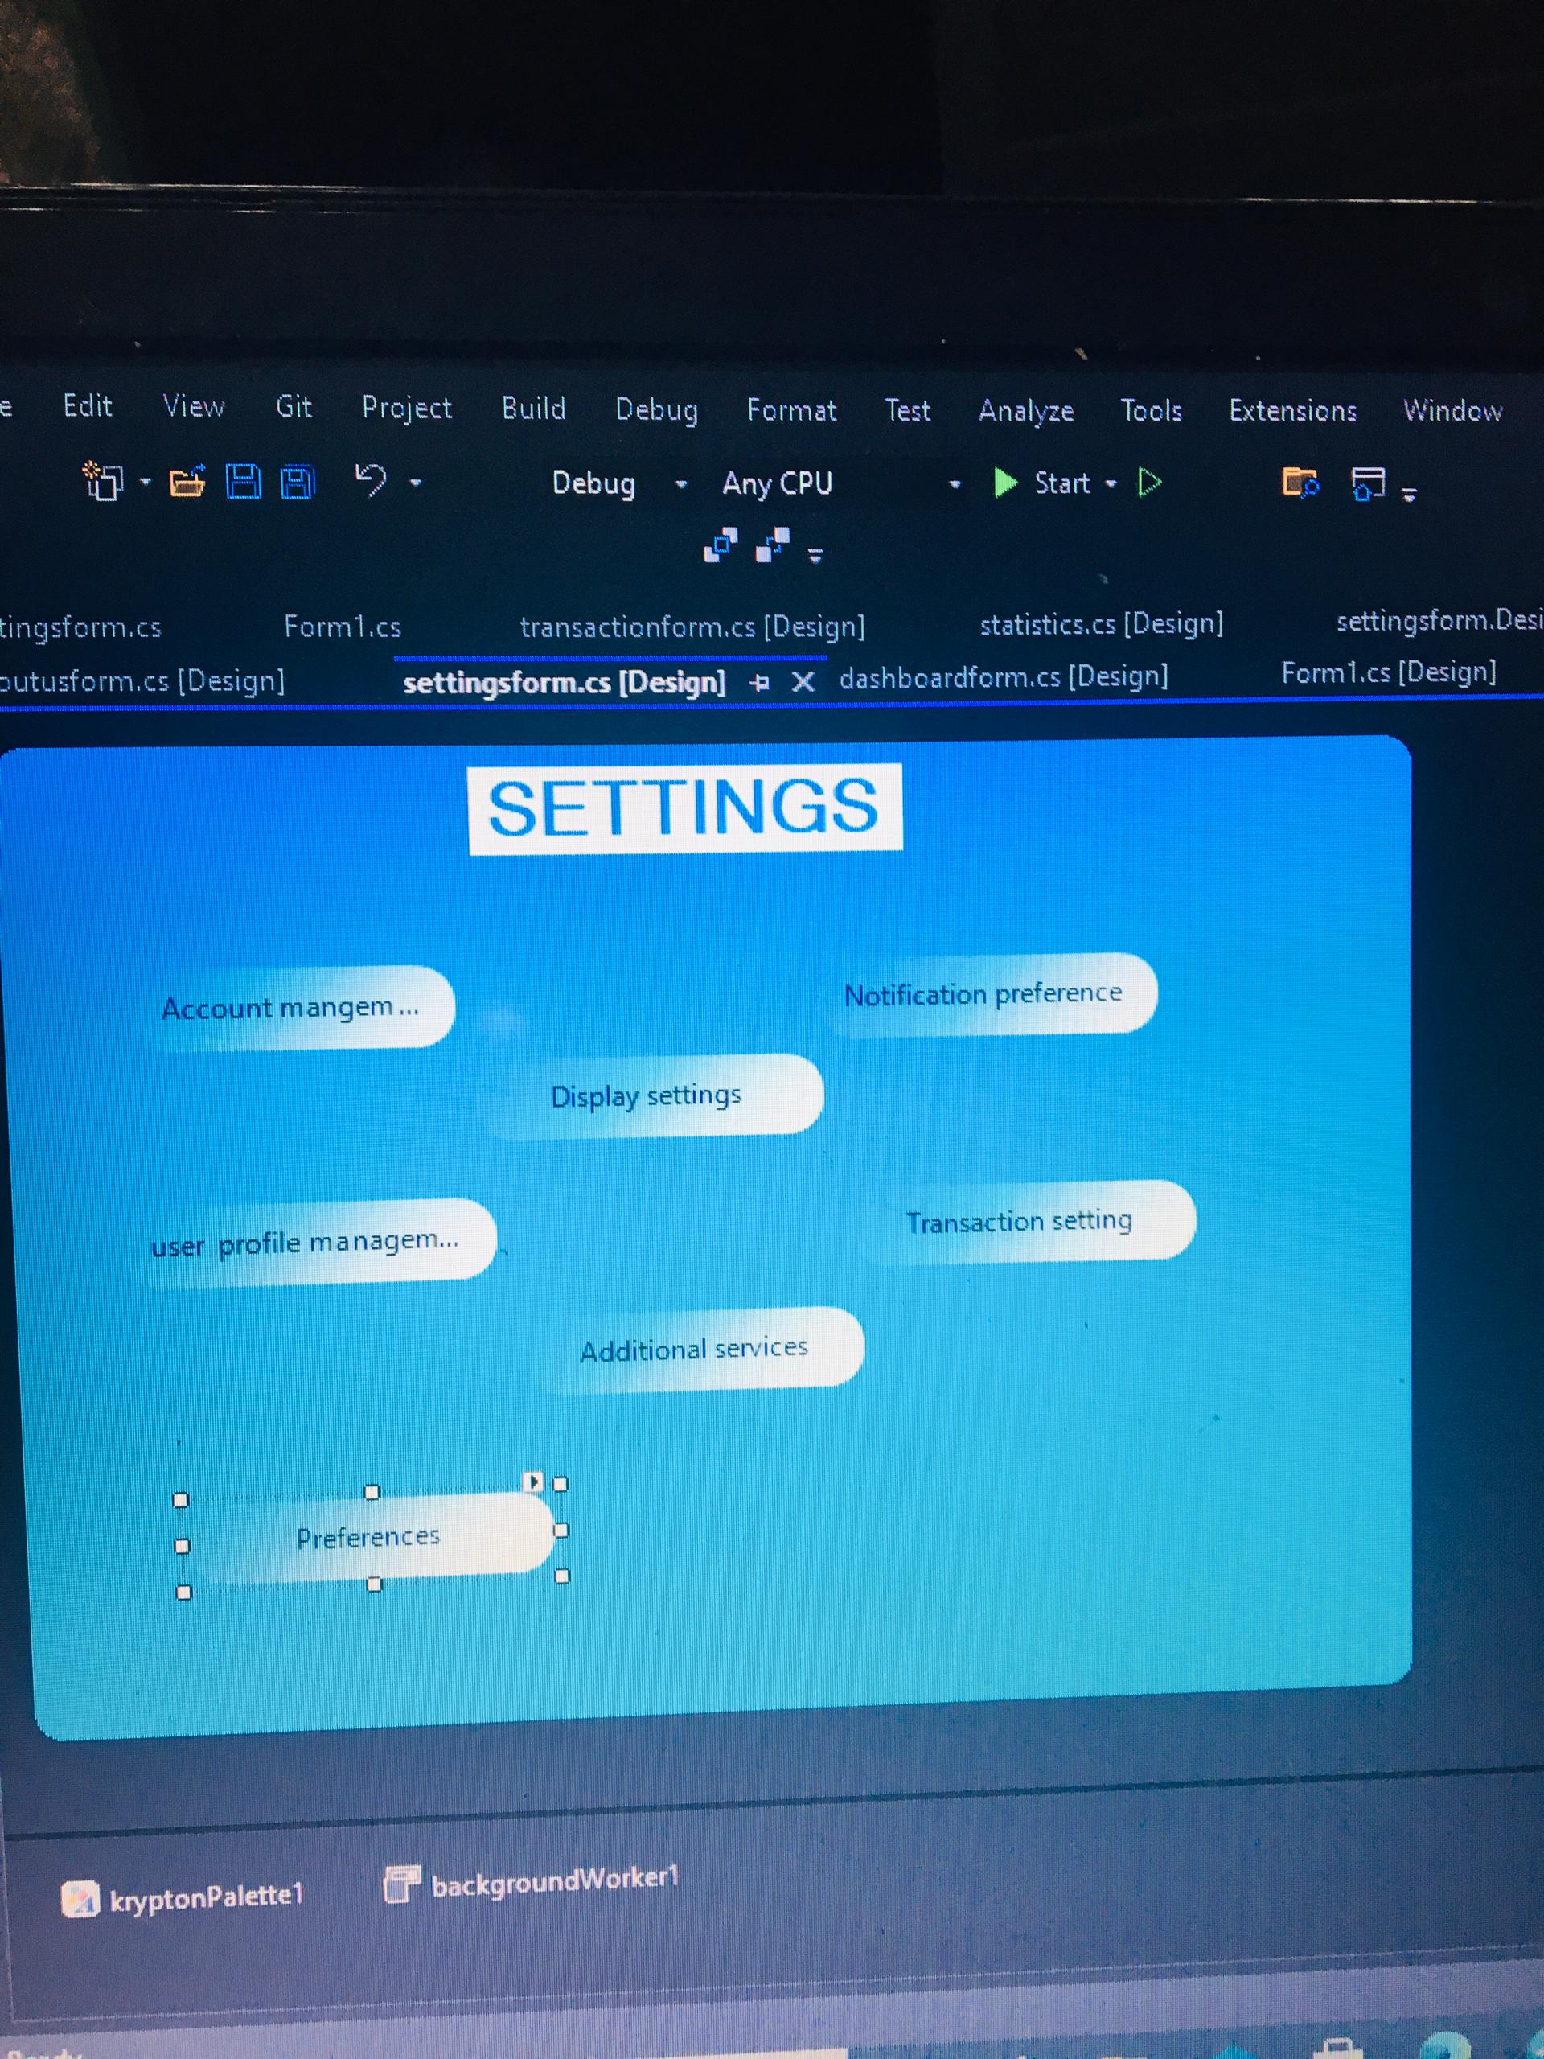
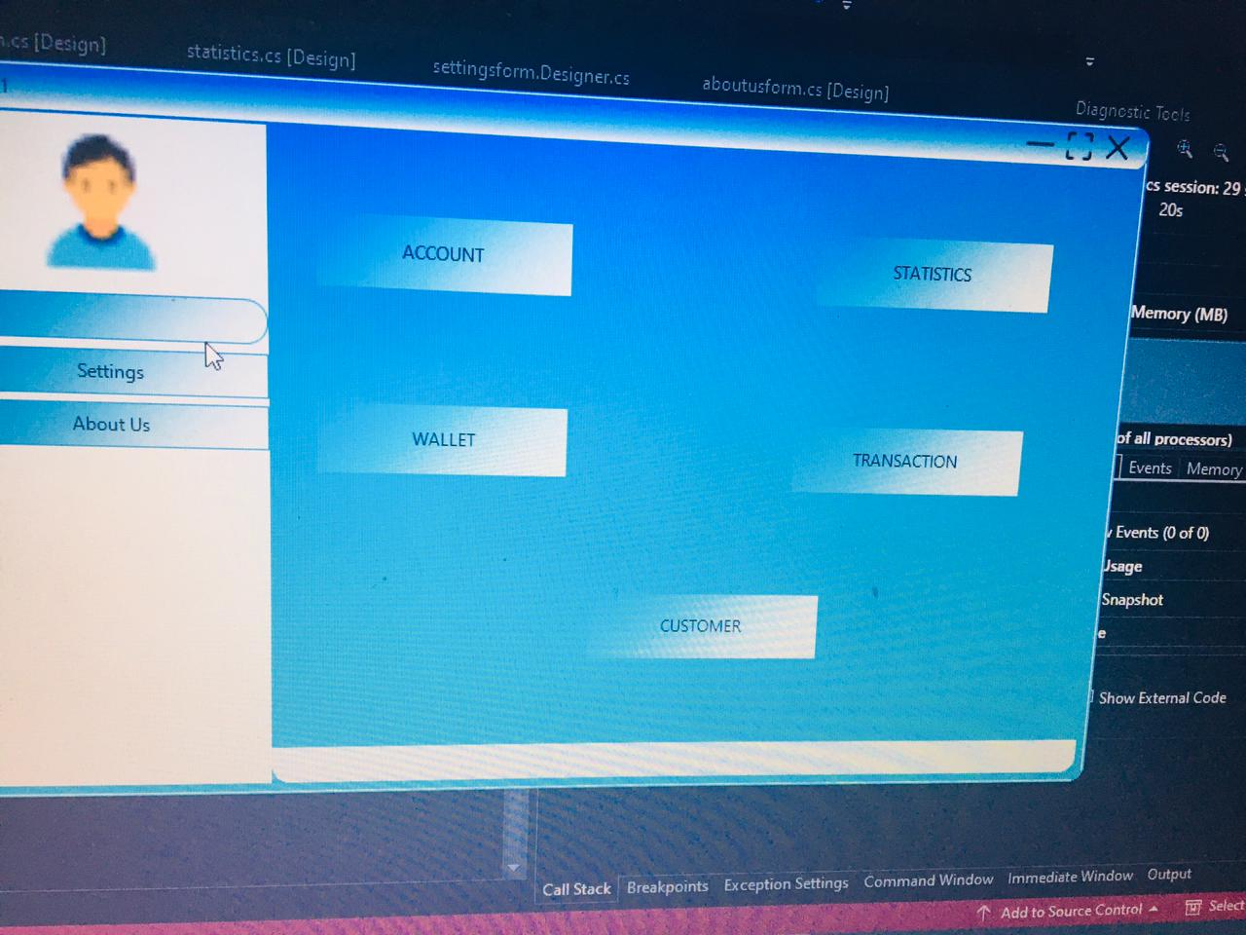
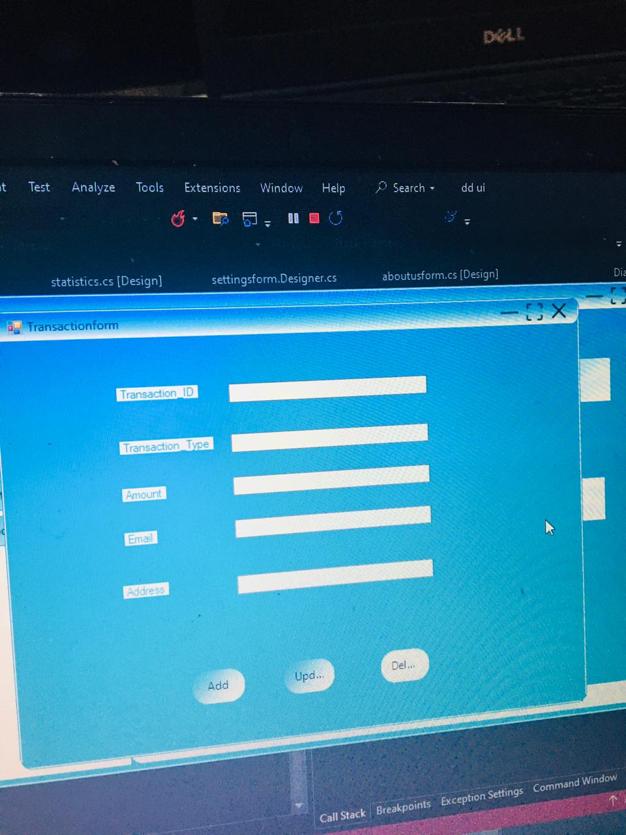

Slide 20
CONCLUSION
The Bank Account Management system is designed to provide users with a secure and efficient way to manage their finances.
The project aims to meet the growing demand fot digital banking digital business banking solutions .

